Slide 1
SQL Analysis: IMDB Movies
Uncovering correlations between movie runtime and audience ratings through SQL-driven analysis (2010–2019).
Manthi Gabriel
7/15/2026

Slide 2
What We'll Cover
Objective and toolstack
Strategy and method
What the data shows
Findings & Takeaways
02.
Manthi Gabriel
7/15/2026

Slide 3
Objective
To explore the relationship between movie runtime and audience ratings using SQL, Pandas, and Seaborn in order to identify trends that could support evidence-based decision-making in the film industry.
Data Source: IMDB Movies Database (2010–2019)
Tools Used: SQL, SQLite, Pandas, Seaborn, Matplotlib

Slide 4
Initial Exploration Findings
SQL Exploration
Joined the movie_basics and movie_ratings tables using movie_id.
Restricted the analysis to movies released between 2010 and 2019.
Excluded records with missing runtime and audience rating values.
Filtered the dataset to include movies with runtimes between 40 and 240 minutes to remove unrealistic values.
Movies with fewer than 1,000 audience votes were excluded to improve the reliability of the ratings and reduce the influence of movies with limited audience feedback.
Used a scatter plot with a regression (trend) line to examine the relationship between movie runtime and audience ratings.

Slide 5
Business Question
Does movie runtime influence audience ratings, and is there an optimal runtime associated with higher-rated movies?

Slide 6
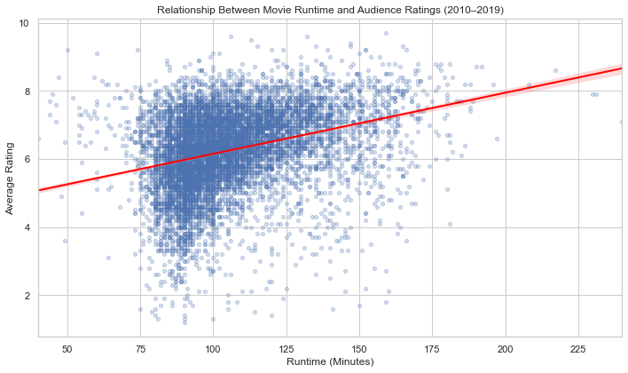

Slide 7
Key Findings
Most movies released between 2010 and 2019 have runtimes ranging from 80 to 140 minutes.
Audience ratings are concentrated between 5.5 and 7.5, regardless of movie length.
The regression line is nearly flat with a slight downward slope, indicating little to no meaningful relationship between runtime and audience ratings.
Both highly rated and poorly rated movies occur across nearly all runtime lengths.
The wide dispersion of data points suggests that movie runtime is not a strong predictor of audience ratings.
Other factors—such as genre, storyline, cast, director, production quality, and audience preferences—are likely to have a much greater influence on how audiences rate a movie.

Slide 8
Business Insight
This exploratory analysis found little evidence that movie runtime has a meaningful influence on audience ratings.
Although moderately longer movies are common, the wide variation in ratings suggests that other factors—such as genre, storytelling, cast, and production quality—are more influential.
Future analyses should incorporate these variables to better understand audience preferences.

Slide 9

Thank You
Questions welcome
Gabriel Manthi · July 15, 2026
10.

